Slide 1

Howitzer Simulator
Ahras Ali, Bulbul Arora, Jasmeet Singh

Slide 2


Our Team
Ahras Ali
Bulbul Arora
Jasmeet Singh

Slide 3

Table of contents
01
05
02
06
03
07
04
08
Introduction
Results
Design requirements
Project management
Solution
Future work
Testing
Conclusion

Slide 4
Fun fact
The word "howitzer" is originated from the Czech term "houfnice," which means "a swarm of wasps." This name was given because of the buzzing sound the projectile made as it flew in the air.

Slide 5
01
Introduction

Slide 6
Introduction/Approach
Background:
This project focuses on the development of a Howitzer simulator application, a significant tool for military training and operations. The application, written in Java, employs rigorous testing strategies to ensure accuracy and reliability.
Rationale:
The simulator is designed with a user-centric approach. We prioritized usability over system orientation, focusing on an intuitive and engaging experience. Instead of waiting for implementation after multiple MVPs, our goal was to create a tool ready for deployment with essential features right from the start.
Testing Strategy:
Our comprehensive testing approach ensures reliability and robustness, utilizing various strategies:
Node Coverage with Data Flow
Integration testing
Decision table-based testing
Boundary value testing
Equivalence class testing
System testing via Finite State Machines

Slide 7
02
Design Requirements

Slide 8
Design Requirements
Objectives:
The objective of this project is to create test suites for a Howitzer Firing Simulator. The main objective is not to design the simulator but to design tests in order to verify the kinematic and dynamic of the simulator.
Functions:
The functions of the Howitzer must include loading the projetial, launching the projetical and analyzing the results
Testing:
The project must include Integration testing and system testing
The project must include testing paths and node coverage.
Code Management:
The code must be managed on a cloud environment and accessible to all members of the team.

Slide 9
Design Constraints
Economic Factors:
The project will consider the cost of the equipment, the cost of implementation, operational costs and maintenance costs. Furthermore, The project will assess ways of cost reduction for long term deployment.
Regulatory Compliance (Security and Access):
The simulator should abide by the security standards and the protocols to protect sensitive information such as encryption of the data
and access control measures.
Ethics:
The main ethical consideration when designing the simulator is not having any harmful or malicious intentions and it should
strictly follow the training rules when in use. Data privacy should be handled in a secure manner and following regulatory data protection laws.
Societal Impacts:
The design of the stimulator should be usable by all groups of people, meaning that the design should be user friendly and
environmentally friendly. The main considerations would be interface and accommodating individuals with disabilities.

Slide 10
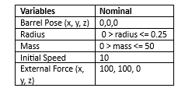
Testing Boundaries

Slide 11
03
Solution

Slide 12
Solution
MVP 1: Basic Functionality
Load the simulator
Set the barrel position
Fire the simulator
Calculate the trajectory
Note: MVP 1 is functional, but lacks safety measures.
MVP 2: Testing and Safety Integration
Integrate safety measures using guards and triggers
Implement testing strategies:
Unit Testing
Boundary Value Testing
Decision table-based testing
Note: MVP 2 aims to ensure the simulator meets project criteria by enhancing functionality and safety.
MVP 3: Enhanced Features and Design
Calculate maximum height reached by projectile
Implement an object-oriented design with different classes
Additional enhancements building upon MVP 2
Note: This stage focuses on expanding features and refining the system design.
Notes:
•For each solution, describe the following
•Application Design and Implementation
•Test cases and results
•Analysis of the solution
•
•Compare all the solutions to answer the following
•How a solution is better than the previous solutions (if applicable)?
(use a table to compare the solutions)

Slide 13
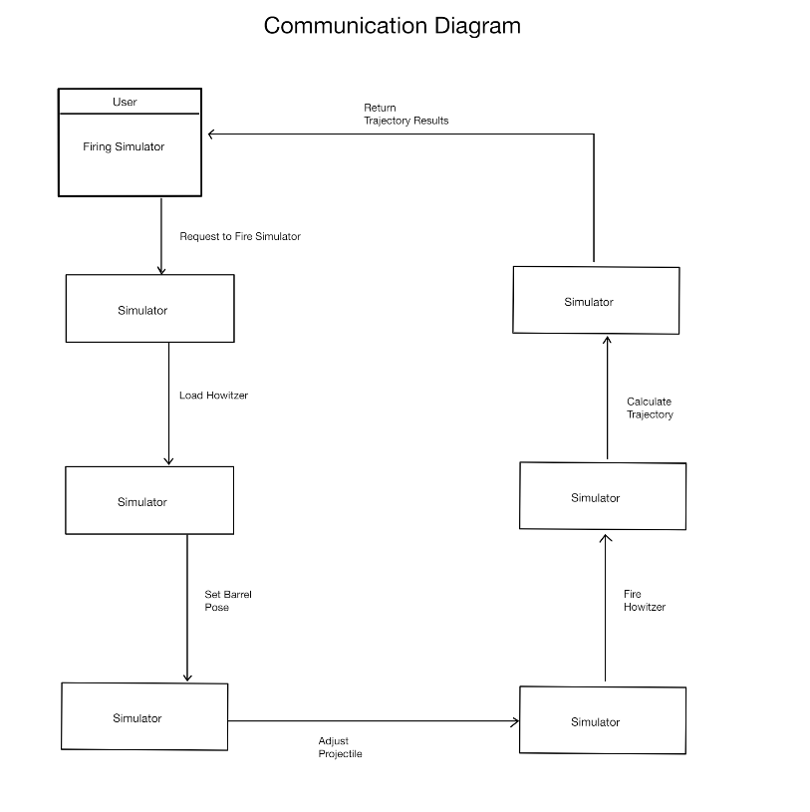
Communication Diagram Version 1

Slide 14
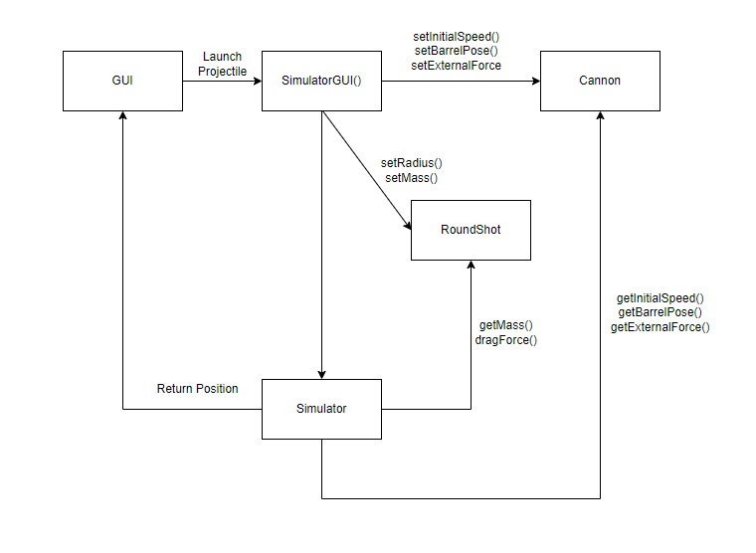
Communication Diagram

Slide 15
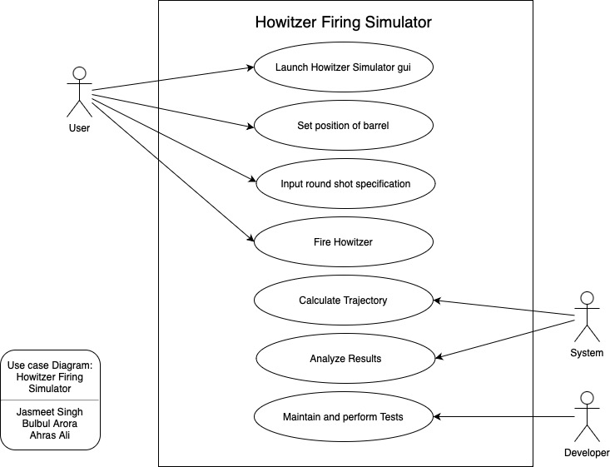
Use Case Diagram

Slide 16
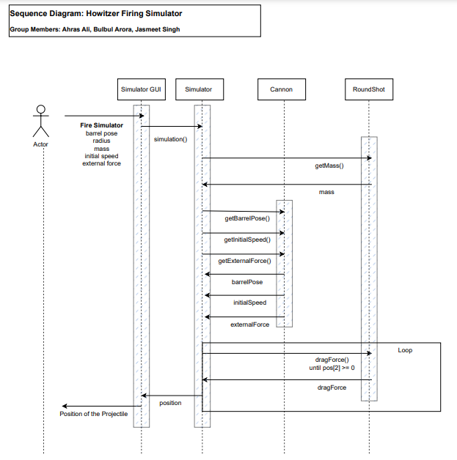
Sequence Diagram
Our sequence diagram is a diagram that describes the interactions between different components of our project such as the gui, simulator, canon and RoundShot.
The main focus of our sequence diagram is the loop which runs until the z component is zero which mean the round shot has impacted the ground. In this loop, the simulator talks to the round shot class to get the new drag force for each iteration of the loop.

Slide 17
04
Testing

Slide 18
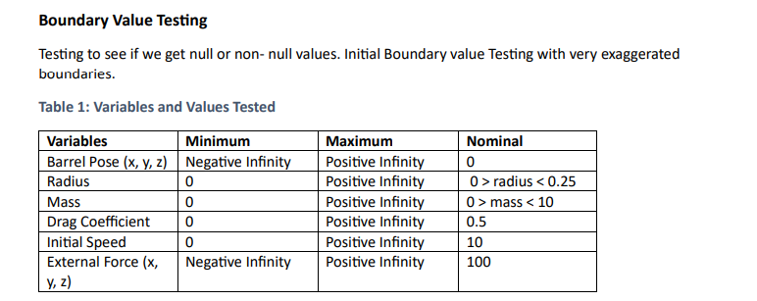
Boundary Value Testing (Version 1 and 2)

Slide 19
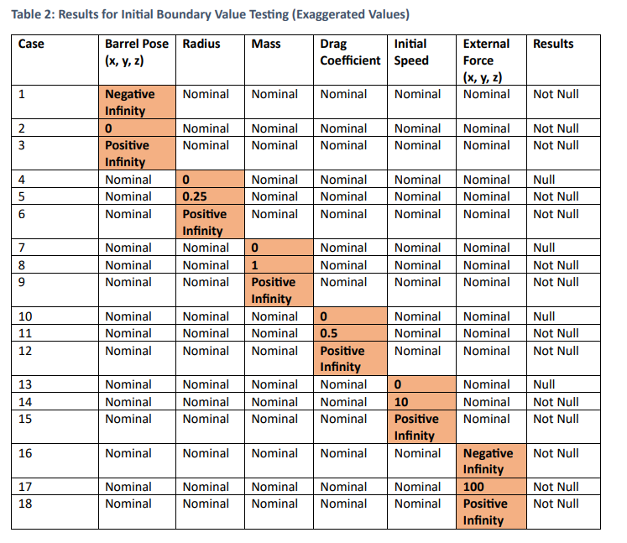
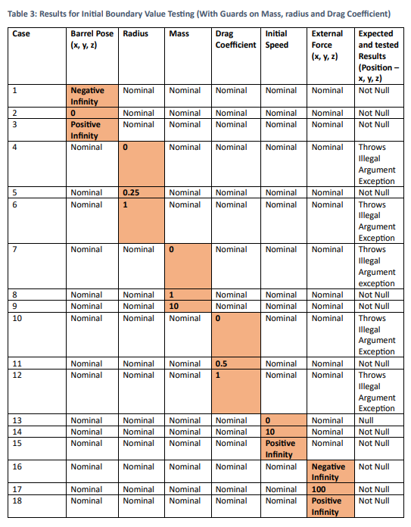
Boundary Value Testing (Version 1 and 2)

Slide 20
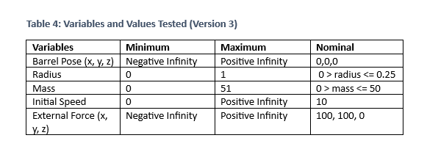
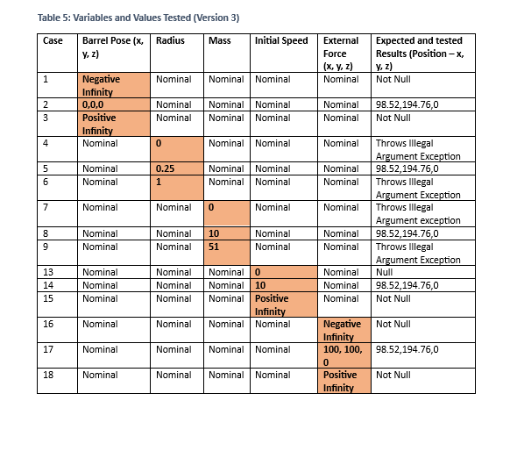
Boundary Value Testing (Version 3)

Slide 21
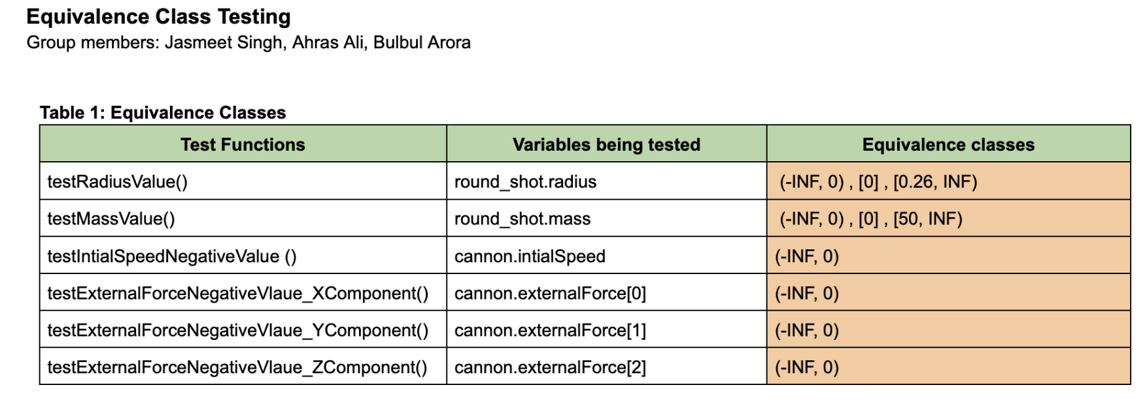
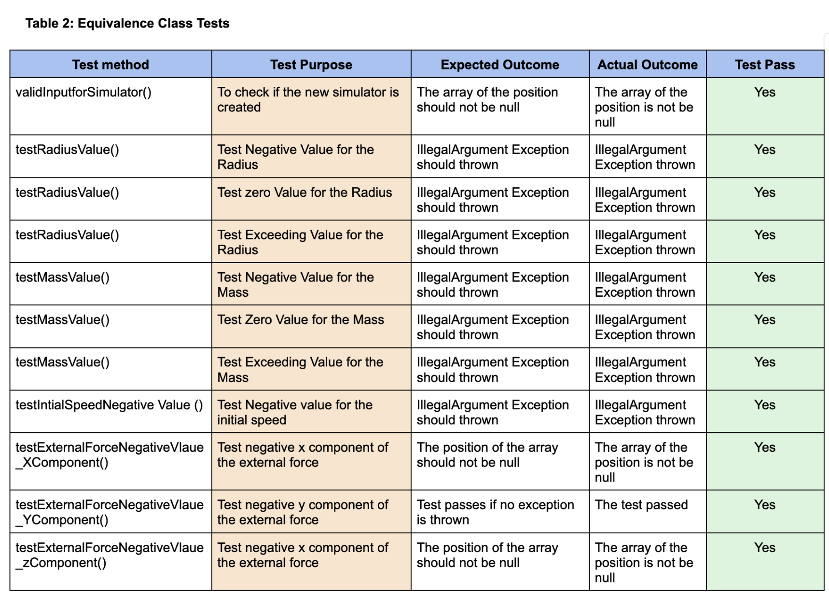
Equivalence Class Testing
Equivalence Class Testing, also known as Equivalence Partitioning, is a black box software testing technique that divides the input data of a software unit into partitions of equivalent data from which test cases can be derived.
This technique reduces the total number of test cases that need to be developed, while still reasonably ensuring that all scenarios are covered.

Slide 22
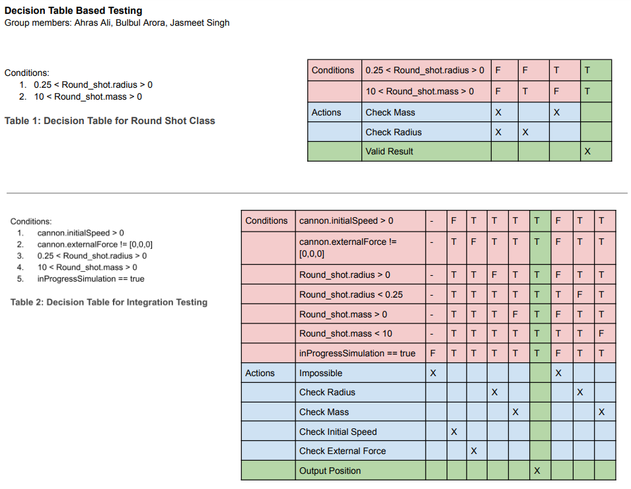
Decision Table Testing
Decision Table Testing is a black box test design technique that uses a table to represent different combinations of inputs and their outputs. In our project, we used black box testing to determine our conditions for the round shot class and the integration testing.

Slide 23
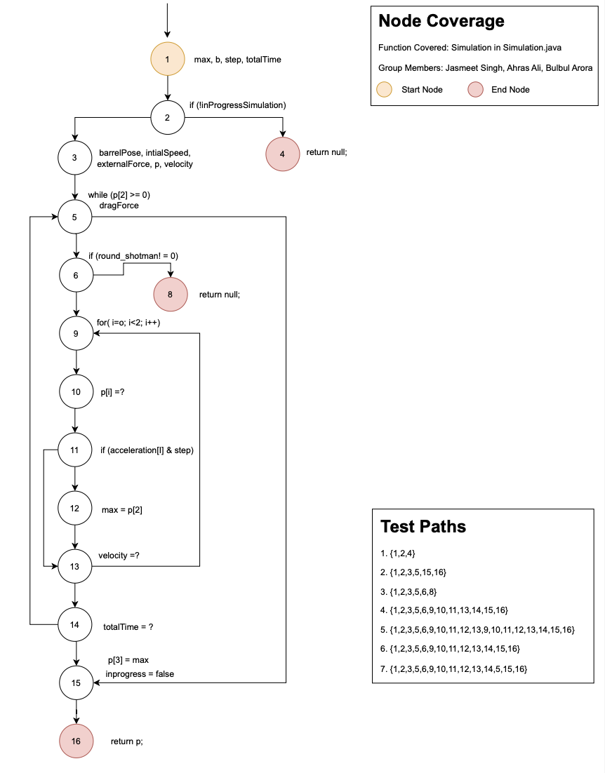
Node coverage
Node coverage testing in the context of data flow refers to a white-box testing technique that not only ensures each executable statement or node in the source code has been executed at least once, but also tracks the specific variables' values and the paths these variables take through the program.

Slide 24
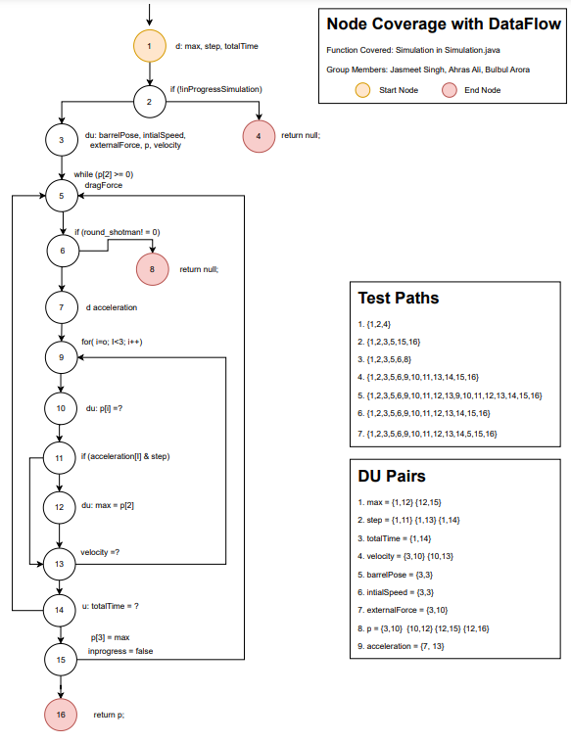
Node coverage & Data flow
Data flow testing focuses on the points at which variables receive values (definition points) and the points at which these values are used (use points), along with the routes data takes between definition and use (DU paths).

Slide 25
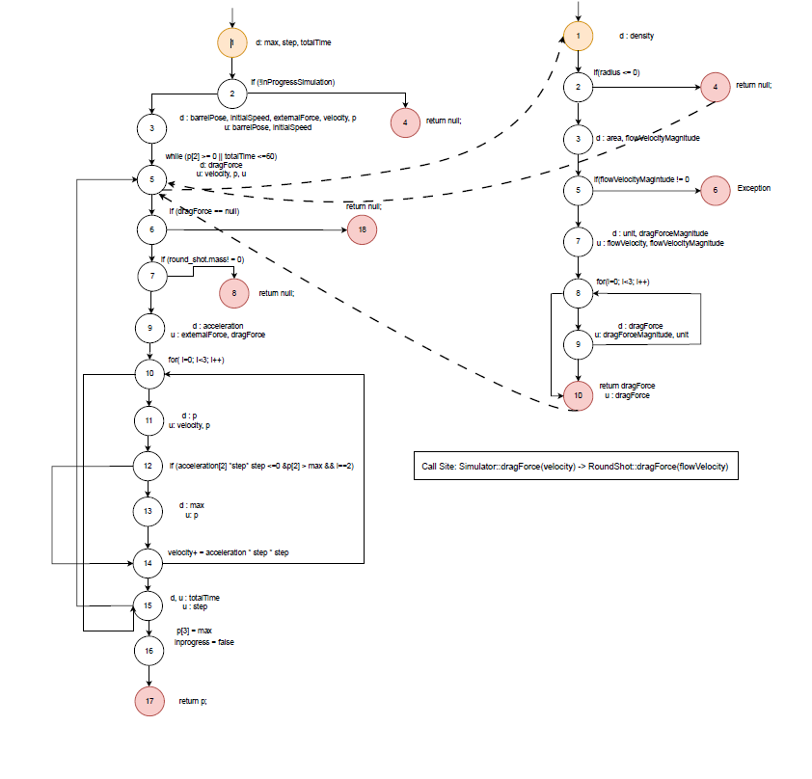
Integration Testing
We created a control flow graph for our Simulator::simulation() method and the RoundShot::dragForce() method.

Slide 26
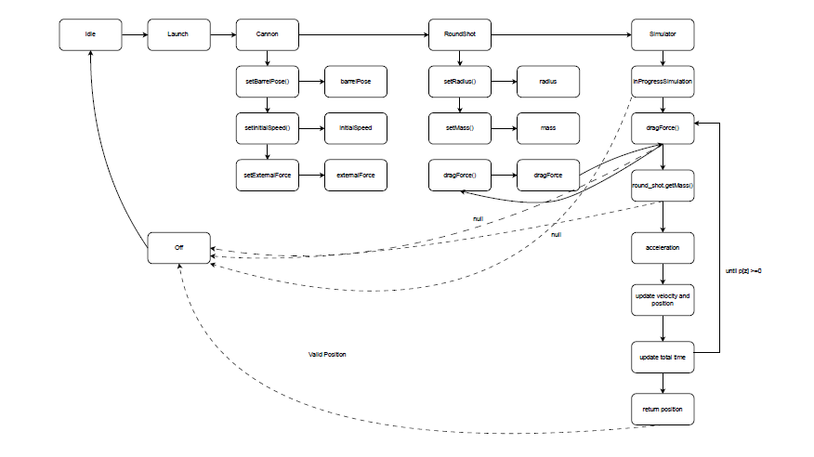
FSM
We created an FSM to show what states our system can be in and how the state variables change the state of the system.

Slide 27
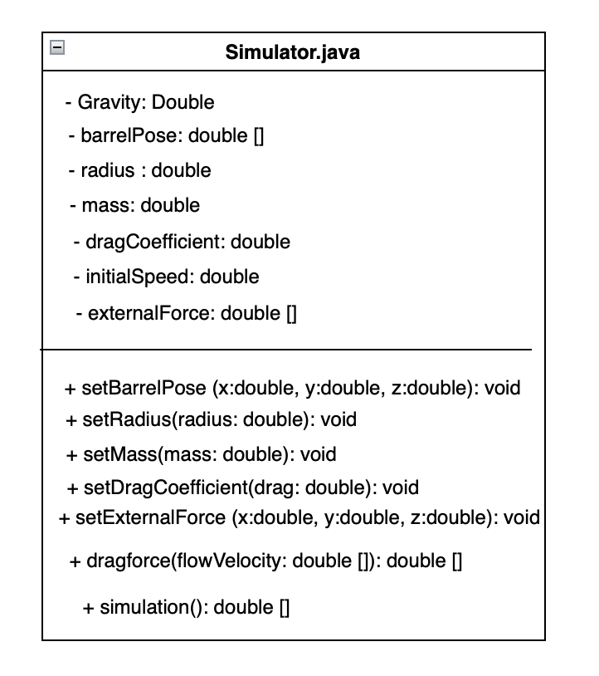
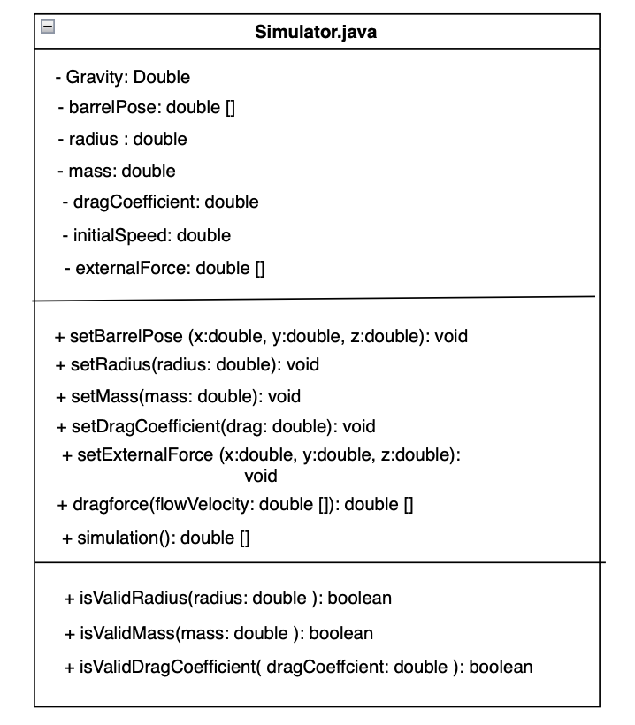
Class Diagram
MVP 1
Class Diagram
MVP 2

Slide 28
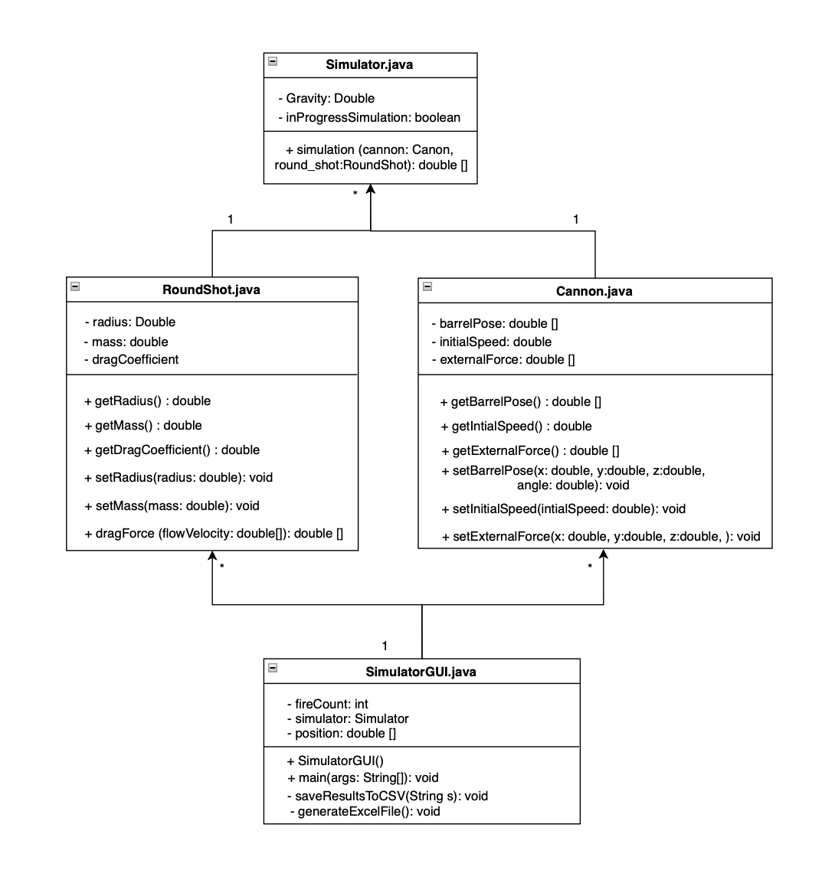
Class Diagram
MVP 3

Slide 29
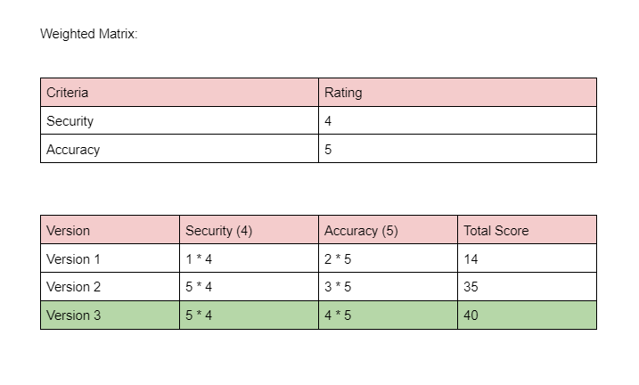
Weighted Matrix

Slide 30
05
Results

Slide 31
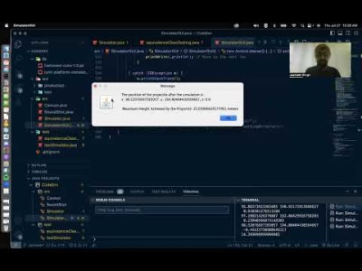
Demo
https://www.youtube.com/watch?v=-Wuv2luPems&t=3s

Slide 32
06
Project Management

Slide 33
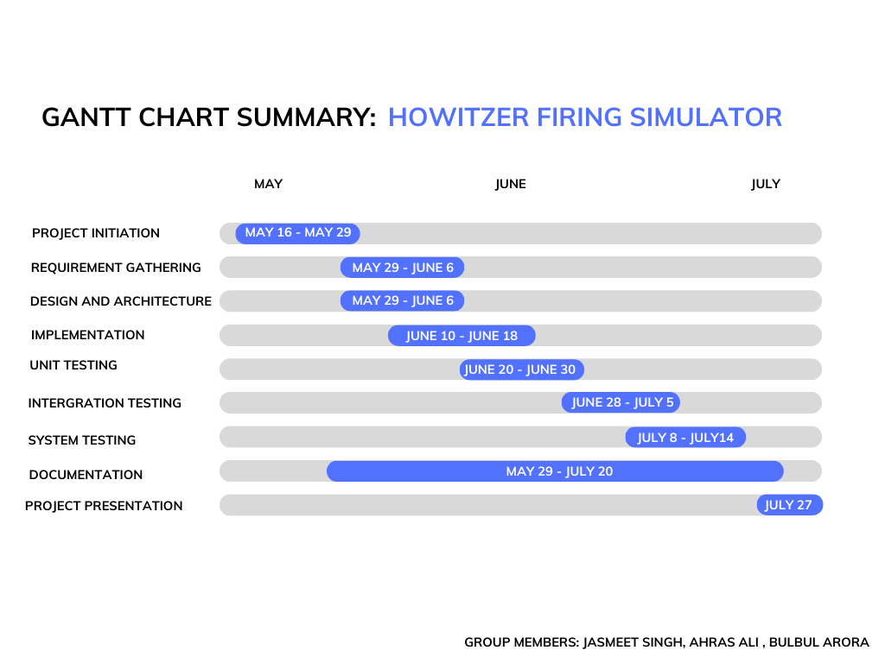
Project management

Slide 34
07
Future Work

Slide 35
Future work
Model Specificity: Increase the accuracy of simulations by tailoring them to specific Howitzer models based on real-world data from the military.
Weather Considerations: Incorporate wind and rain factors to make the simulations more realistic and account for their impacts on Howitzer operation.
Augmented and Virtual Reality: Integrate AR and VR technologies to provide immersive training experiences, enabling users to interact with the simulator in a more engaging and realistic environment.
User Experience: Continuously refine and improve the user interface and experience, based on user feedback and testing, to make the simulator more intuitive and user-friendly.

Slide 36
08
Conclusion

Slide 37
Conclusions
Overview: Our team successfully developed a Howitzer simulator, focusing on both usability and testing.
Development: Throughout the development process, we used testing strategies to ensuring our application's reliability, robustness, and safety.
Approach: We approached the project in three MVP stages, starting MVP 1 from basic functionality to MVP 2 of safety measures, and finally, refining and expanding features for MVP 3.
Future: To further elevate the simulation experience, we plan to continuously improve our application for future use.
Closing Remarks: Our Howitzer simulator is more than a training tool; it's an easy to use, realistic, and safe environment for learning the Howitzers operations.

Slide 38
Thanks!
Do you have any questions?

